Slide 1
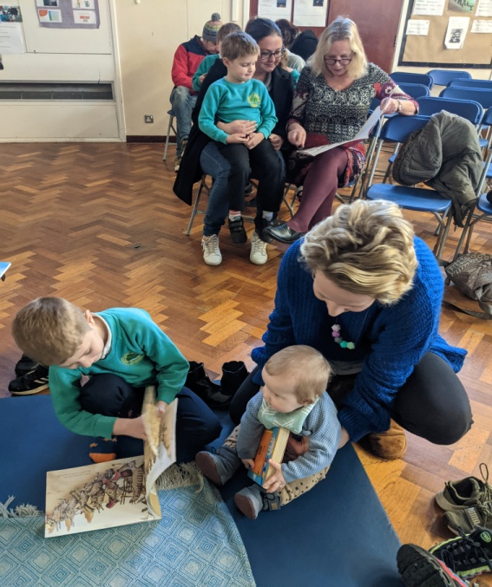
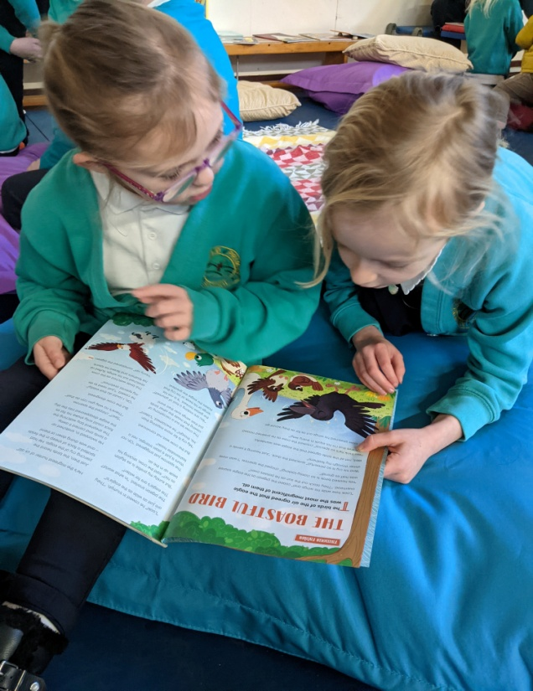
World Book Day
March 2nd 2023

Slide 2
World Book was created by unesco ion 23rd April 1995. It is a worldwide celebration of books and reading and is marked in over 100 countries in the world. The first world book day in the uk took place in 1997 to encourage young people to enjoy the pleasure of books.

Slide 3
World book day 2023
World Book Day Books
In School
Activities in Classrooms
5 children from each class to have their photo taken in the library
A Live BBC Lesson (11:00)
Paired reading with another class
Acorns and Beech
Maples and Rowan
Silver Birch and Elm
Willow and Oak

Slide 4
Our Favourite Authors
5. George Orwell
4. J K Rowling
3. Enid Blyton
2. Julia Donaldson
1. Roald Dahl

Slide 5
The Books....

Slide 6
Top three books
Danny the Champion of the World
Tiger Who Came For Tea

Slide 7
The Winner is!!!

Slide 8
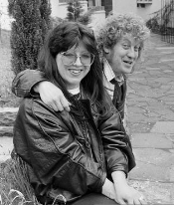
A story about a bookseller, an author and A Famous Book...

